Slide 1

</CODEPLAYER> Submitted by: MANSI VERMA 181500372 DEPARTMENT OF COMPUTER ENGINEERING AND APPLICATIONS Institute Of Engineering and Technology GLA University Mathura-281406 2020

Slide 2
1
5
AIM OF PROJECT
HTML
2
CSS
Working
6
Content
3
7
JavaScript
Uses
4
8
jQuery
Future Scope

Slide 3
HTML
HTML

Slide 4
About HTML
HTML
HTML stands for Hyper Text Markup Language
HTML is the standard markup language for creating Web pages
HTML describes the structure of a Web page
HTML consists of a series of elements
HTML elements tell the browser how to display the content
HTML elements label pieces of content such as "this is a heading", "this is a paragraph", "this is a link", etc.

Slide 5
NEED of HTML
HTML
HTML is increasingly used as the basis of stand-alone applications that use a GUI
You cannot edit them if you don't have the original software, or know enough about HTML and how it works to be able to make small edit yourself.
You can include images, videos, sound clips, flash movies, applications and other HTML documents directly inside an HTML document.

Slide 6
CSS
CSS

Slide 7
ABOUT CSS
CSS
CSS is a way to style HTML, Whereas html is the content, the style sheet is the presentation of that document.
There are standards and rules that apply to CSS just like there are with HTML.
CSS is separate “language” but it is not HTML . It enhances the display capabilities of HTML .The same HTML editors can be used to write CSS( Notepad++, Notepad, among others ).

Slide 8

Ways to apply CSS
CSS
INLINE - Affects only the element applied to
INTERNAL - Affects only the elements in single file.c
EXTERNAL - Linked to an unlimited number of files.

Slide 9
Advantage of CSS
CSS
There’s a huge number of ways that we can style our page using Cascading Style Sheets.
The real advantage is that they’re completely separate from HTML itself which is a very useful job than of keeping style and content separate.
It’s easier to update and maintain and it has a really useful feature that you could completely restyle your website without actually changing html of the content at all.

Slide 10
JavaScript
JavaScript

Slide 11
ABOUT JS
JavaScript
A scripting language that works with HTML to enhance web pages and make them more interactive.
Runs in a Web Browser(client-side).
Embedded in HTML files and can manipulate the HTML itself.

Slide 12
Why use JavaScript
JavaScript
To add dynamic function to your HTML.
JS does things that HTML can't -like logic.
JavaScript can validate the data the user enters into the form, before it is sent to your Web Application.

Slide 13
jQuery
jQuery

Slide 14
jQuery
jQuery
Well, J Query is a Javascript framework that means it sits on top of javascript and its main purpose is to make things that are a little bit complicated on Javascript a lot simpler. And essentially it gives us a lot more power with a lot less code which makes writing interactive powerful websites a lot easier.
It also has a bunch of plugins which allow you to do really cool stuff easily.

Slide 15
AIM OF PROJECT
AIM

Slide 16
AIM OF PROJECT
</CODEPLAYER> is designed in such way that user can code and can see the live output of their code.

Slide 17
WORKING
WORKING

Slide 18
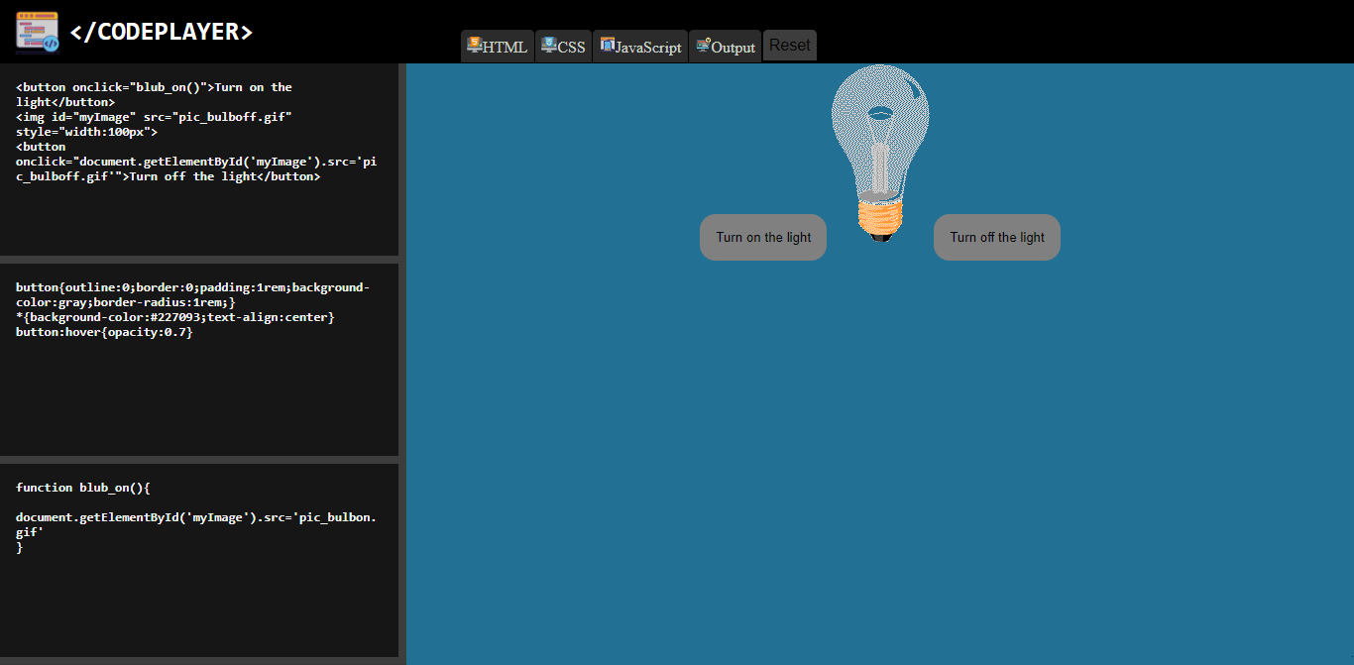
WORKING
HTML PANEL
OUTPUT PANEL
HTML PANEL
CSS PANEL
J
JS PANEL
After opening of </CODEPLAYER> , the screen looks like this by default .

Slide 19
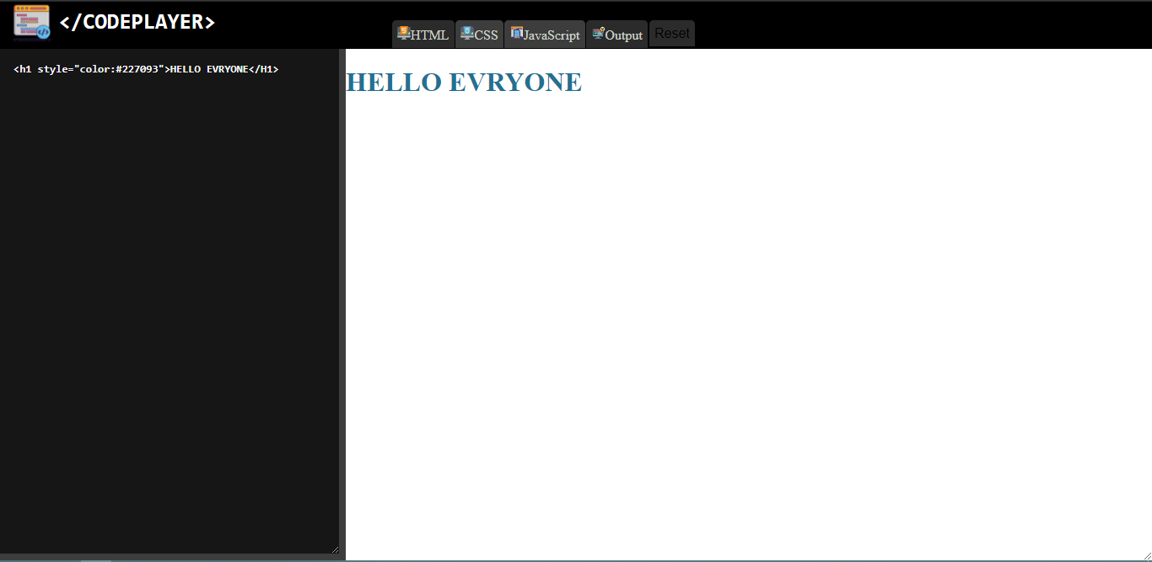
Working of HTML Panel
WORKING

Slide 20
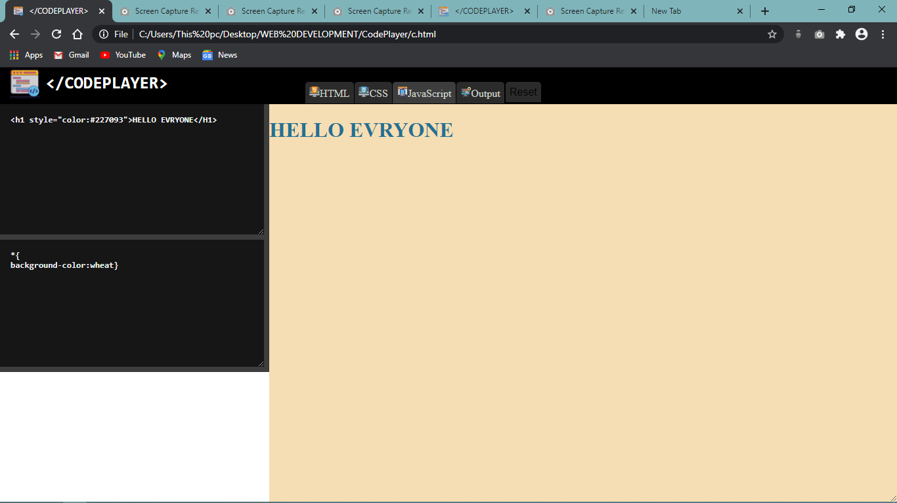
Working of CSS Panel
WORKING

Slide 21
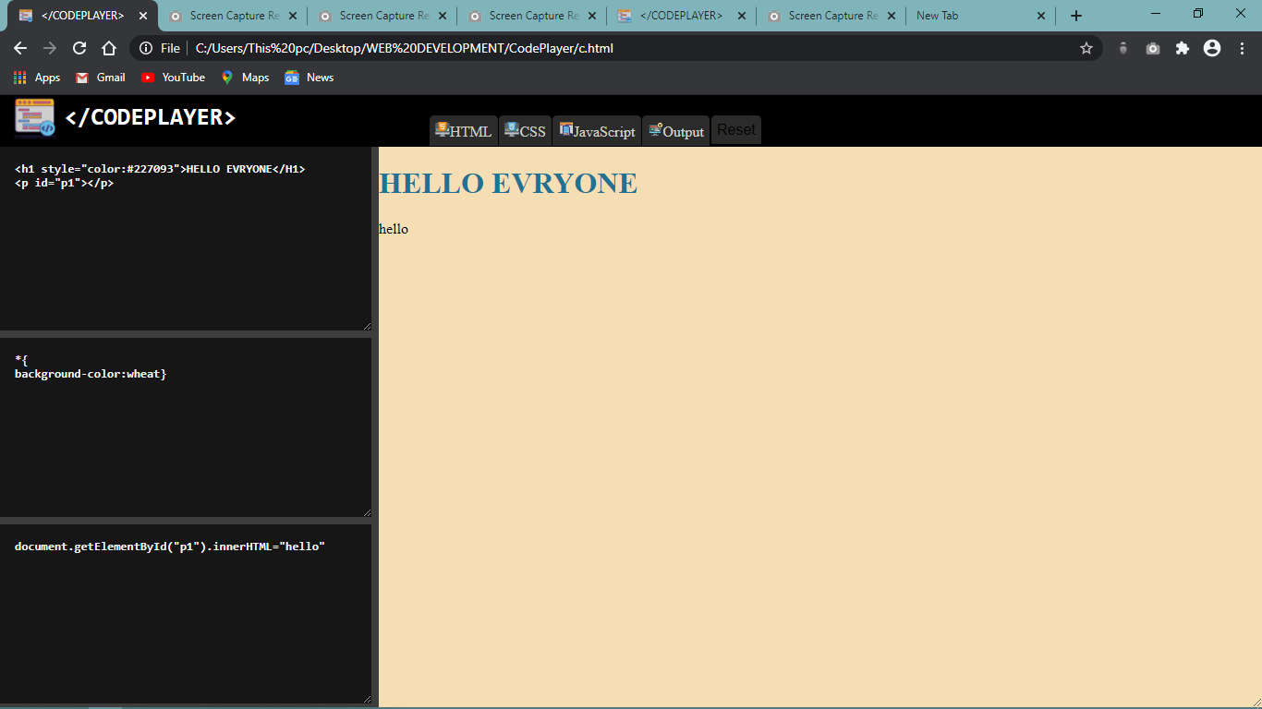
Working of JavaScript
WORKING

Slide 22
Advantages

Slide 23
ADVANTAGE
It is the playground for the front-end side of the web.
</CODEPLAYER> is great for testing out bugs, collabrating and finding new inspiration.
It works by allowing you to create code, which are sets of HTML, CSS, JavaScript.
It is free of cost.
Enter your code in the editor and see the preview changing as you type

Slide 24
Future Scope
Future Scope

Slide 25
Future Scope
1
2
3
Scope for Improvement
</CODEPLAYER>
as Application
BACK-END
This can work even better after making changes in it.
We can make </CODEPLAYER> as an application
We can add back-end to the code player to save the user's data till last commit.

Slide 26
Thank you!

